Slide 1
Early pregnancy complications
Sanjeewa Padumadasa

Slide 2
Ectopic pregnancy
Defined as implantation of a conceptus outside the normal uterine cavity
Common sites
  Fallopian tubes (95%) – ampulla, isthmus, fimbrial end, interstitium
  Ovaries (3%)
  Peritoneal cavity (1%)
What do you mean by heterotopic pregnancy?

Slide 3
Aetiological factors
Previous pelvic infection
Previous ectopic pregnancy
Previous tubal surgery
Subfertility
Use of assisted reproductive techniques

Slide 4
Diagnosis
Symptoms
Abdominal pain
Vaginal bleeding
Shoulder tip pain
faintishness

Slide 5
Diagnosis contd……
Transvaginal ultrasound
  Extrauterine sac with a live embryo
  Adnexal mass
  Pseudo sac
  Free fluid in the pelvis
Serum beta hCG level
  greater than 1500 IU/l and an empty uterus
  suboptimal rise – ectopic pregnancy or a non-viable IUP (85% viable IUPs show a 66% increase over 48 hours)

Slide 6
Management
Expectant
Medical
Surgical

Slide 7
Expectant management
Majority of ectopic pregnancies will resolve through regression or a tubal abortion without any treatment
Criteria
  Haemodynamically stable
  asymptomatic
  Serum beta hCG level <1000 IU/l
  Adnexal mass <4 cm on TVS
  <100 ml free fluid
Follow up

Slide 8
Medical management
Methotrexate
Mode of action – a folic acid antagonist, inhibits DNA synthesis in trophoblastic cells
Criteria
  Haemodynamically stable
  Minimal or no symptoms
  No free fluid
  Adnexal mass < 4 cm
  No fetal heart beat
  Serum beta hCG level < 3000 IU/l

Slide 9
Contraindications to the use of methotrexate
  Liver disease
  Renal disease
  Haematological disorder
  Active infection
  Immunodeficiency
  Breastfeeding
Follow up with serum beta hCG level
What are the other instances where methotrexate is used?

Slide 10
Surgical management
Laparotomy vs laparoscopy
Laparotomy – in a haemodynamically unstable patient
Advantages of laparoscopic surgery
  Less blood loss
  Shorter operating time
  Less pain
  Shorter hospital stay
  Shorter convalescence

Slide 11
Surgical management contd…..
Salpingotomy vs salpingectomy
Salpingotomy is performed if the contralateral tube is diseased
The rates of persistent trophoblastic disease and repeat ectopic are higher with salpingotomy than salpingectomy
The subsequent IUP rates are similar

Slide 12
Miscarriage
Defined as a pregnancy that ends spontaneously before the fetus has reached a viable gestational age
Incidence – 20%
Majority occurs in the first trimester
Commonest reason is a chromosomally abnormal conceptus

Slide 13
Types of miscarriage
Threatened
Inevitable miscarriage
Incomplete
Complete
Missed
  What are the clinical features?

Slide 14
Management
Expectant
Medical
Surgical

Slide 15
Expectant management
Avoids surgery
Avoids general anesthesia
Complications rare

Slide 16
Medical management
Prostaglandins are used eg- misoprostol
Vaginally or orally
In missed miscarriage, mifepristone is added to promote cervical ripening and placenta seperation

Slide 17
Surgical management
Dilatation and evacuation
Suction evacuation
Evacuation of retained products of conception

Slide 18
Management of miscarriage
Surgical treatment has a higher success rate than expectant or medical treatment in missed or incomplete miscarriage
Both expectant and medical treatments have an equal success rate in incomplete miscarriage
Medical treatment is more successful than expectant management in missed miscarriage

Slide 19
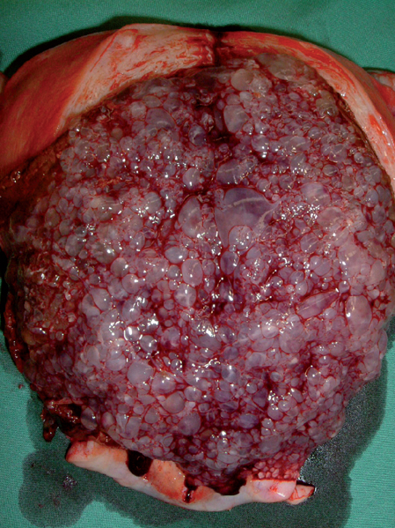
Gestational trophoblastic neoplasia

Slide 20
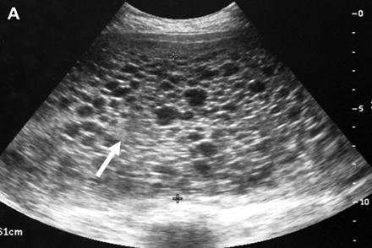
Gestational trophoblastic neoplasia

Slide 21
Clinical features
Irregular vaginal bleeding
Hyperemesis
Excessive uterine enlargement
Early failed pregnancy

Slide 22
Rare clinical features
Hyperthyroidism
Early onset pre-eclampsia
Abdominal distension due to theca lutein cysts
Acute respiratory failure
Seizures

Slide 23
Treatment
Suction curettage

Slide 24
Treatment
Medical evacuation of complete molar pregnancies should be avoided if possible. There is theoretical concern over the routine use of potent oxytocic agents because of the potential to embolise and disseminate trophoblastic tissue through the venous system.

Slide 25
Anti D in GTN
Because of poor vascularisation of the chorionic villi and absence of the anti-D antigen in complete moles, anti-D prophylaxis is not required.
It is, however, required for partial moles.

Slide 26
Follow up
Follow up after GTD is increasingly individualised.
If hCG has reverted to normal within 56 days of the pregnancy event then follow up will be for 6 months from the date of uterine evacuation.
If hCG has not reverted to normal within 56 days of the pregnancy event then follow-up will be for 6 months from normalisation of the hCG level.

Slide 27
Contraception
Women with GTD should be advised to use barrier methods of contraception.
Women should be advised not to conceive until their follow-up is complete.
Women who undergo chemotherapy are advised not to conceive for 1 year after completion of treatment.

Slide 28
Women should be advised not to conceive until their follow-up is complete.
Women who undergo chemotherapy are advised not to conceive for 1 year after completion of treatment.

Slide 29
Hyperemesis gravidarum
Excesive vomiting during pregnancy
Dehydrated
Undernutrition
Marked weight loss
Muscle wasting
Ketonuria
Electrolyte disturbances
Ptyalism – inability to swallow saliva

Slide 30
Risks
Fetal growth restriction
Hyponatraemia – central pontine myelinolysis
Thiamine deficiency – Wernicke’s encephalopathy

Slide 31
Markers of severity
Weight loss > 10 %
Abnormal thyroid function tests
  Raised free T4
  Suppressed TSH
Raised liver transaminases

Slide 32
Management
Exclude other causes of nausea and vomiting
Take vomiting in late pregnancy very seriously
Investigations
  FBC, BU, SE, LFT, TFT
  UFR, urine culture and ABST
  USS of the uterus to exclude multiple pregnancy and hydatidiform mole

Slide 33
Management contd…….
Ensure adequate hydration
  Normal saline
  Hartmann
  Avoid too much of dextrose containing fluids – may precipitate Wernicke’s encephalopathy
  (Wernicke’s encephalopathy is prevented by adding routine adminjstration of oral or intravenous thiamine)

Slide 34
Management contd……..
Cyclizine
Promethazine
Metoclopramide
Domperidone
Ondansetron
Add an antacid, H2 receptor blocker or a proton pump inhibitor
Corticosteroids in refractory cases

